Slide 1

Alignment with Bayesian Region of Measurement Equivalence (ABROME) Approach for Multiple Groups Comparisons
Yichi Zhang, Hok Chio (Mark) Lai
University of Southern California

Slide 2
Agenda
Background of Measurement Invariance (MI) Research
Alignment with Bayesian Region of Measurement Equivalence (ABROME) Framework
ABROME for Multiple Groups
Illustrative Example

Slide 3
Background of Measurement Invariance Research
Existing methods for testing MI
Likelihood ratio test
Goodness-of-fit indices (e.g., RMSEA)
Effect size indices (e.g., d_{MACS} by Nye & Drasgow, 2011)
Limitation of existing MI literature
Difficult to interpret
Not directly supportive of the null hypothesis
Iteratively searching for biased items

Slide 4
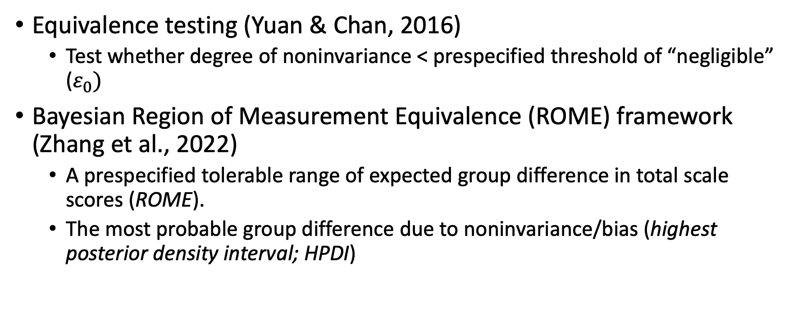
Background of Measurement Invariance Research
Equivalence testing (Yuan & Chan, 2016)
Test whether degree of noninvariance < prespecified threshold of “negligible” ($ε_{0})$
Bayesian Region of Measurement Equivalence (ROME) framework (Zhang et al., 2022)
A prespecified tolerable range of expected group difference in total scale scores (ROME).
The most probable group difference due to noninvariance/bias (highest posterior density interval; HPDI)

Slide 5
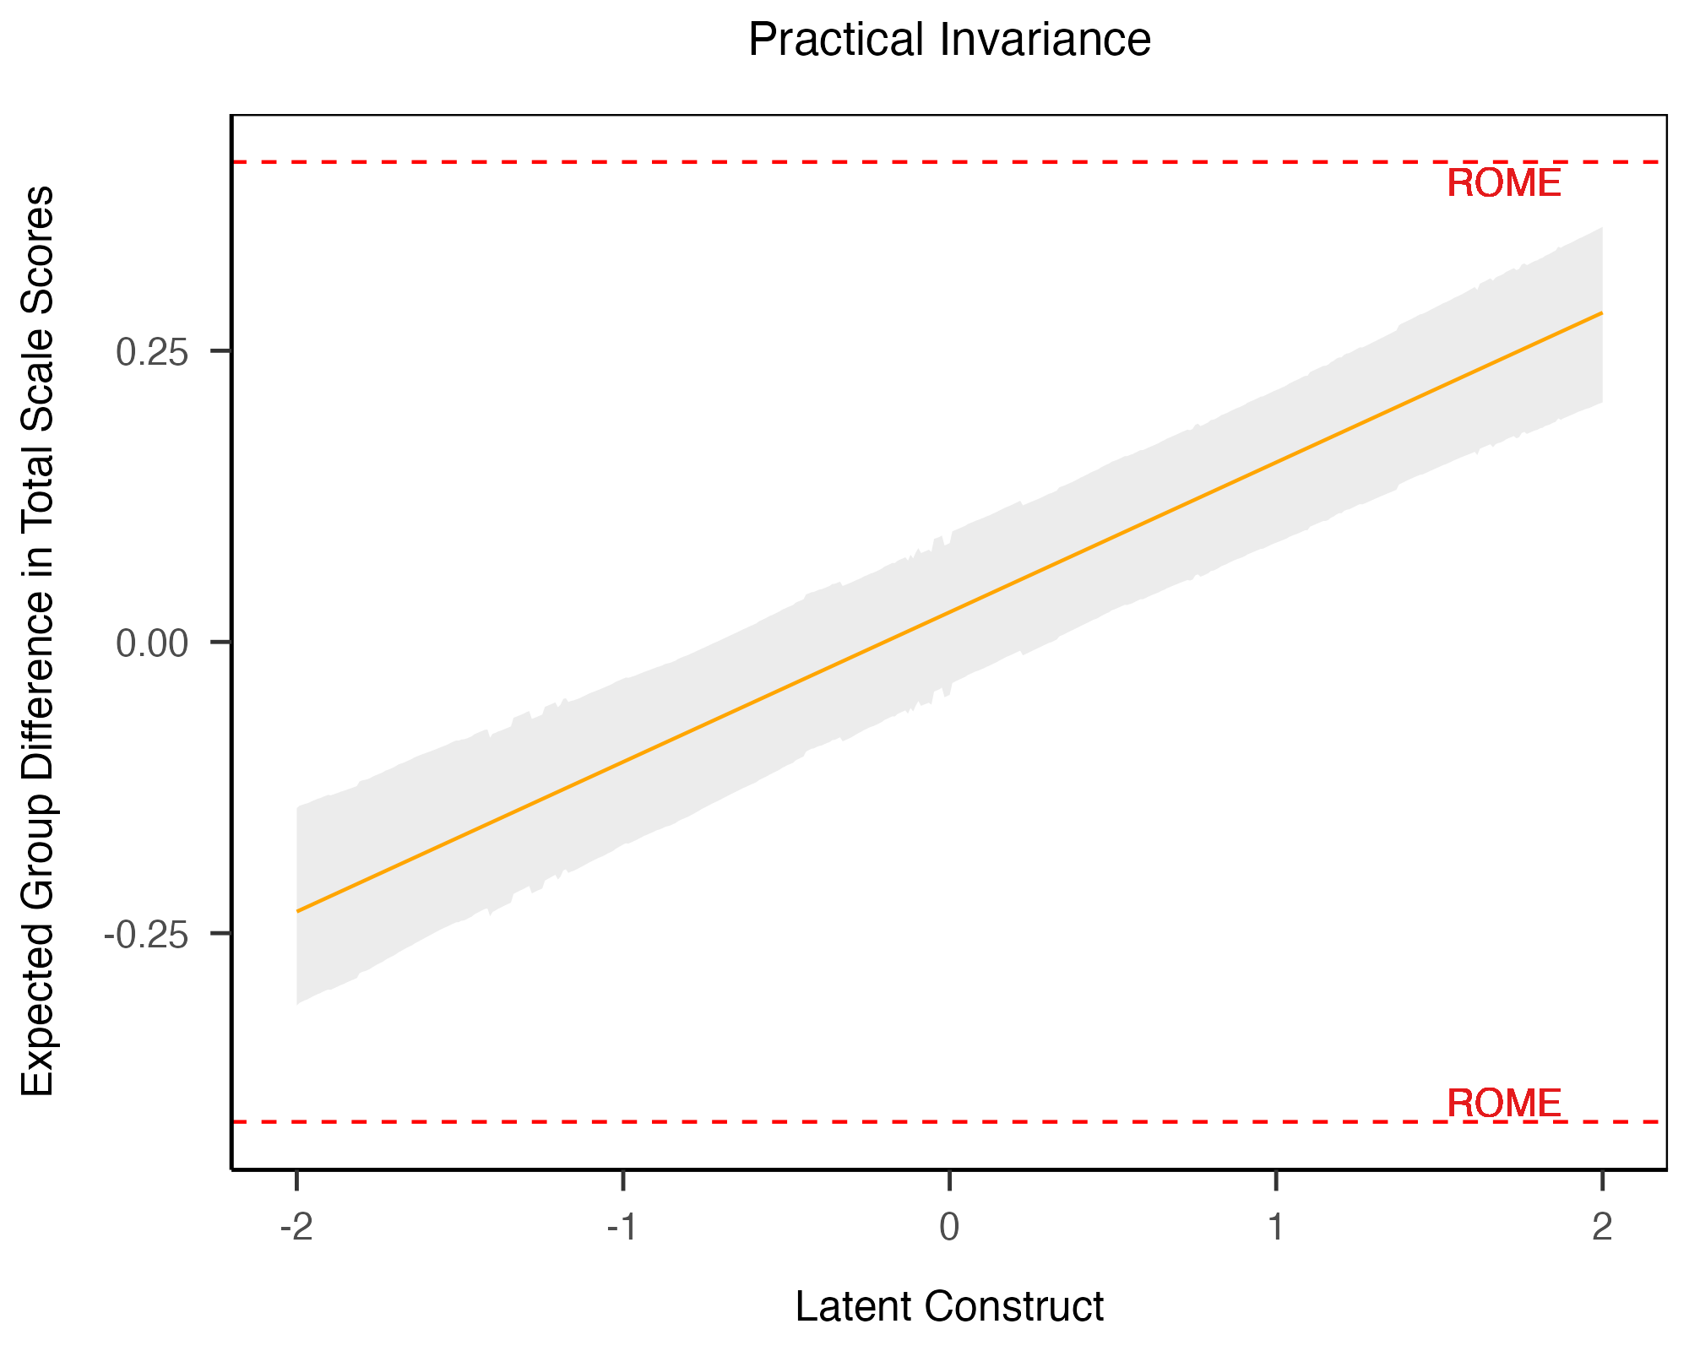
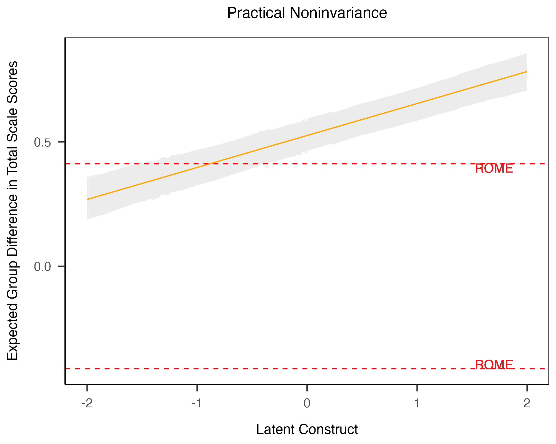
Example Plots of Bayesian ROME Framework
Practical Invariance
Practical Noninvariance

Slide 6
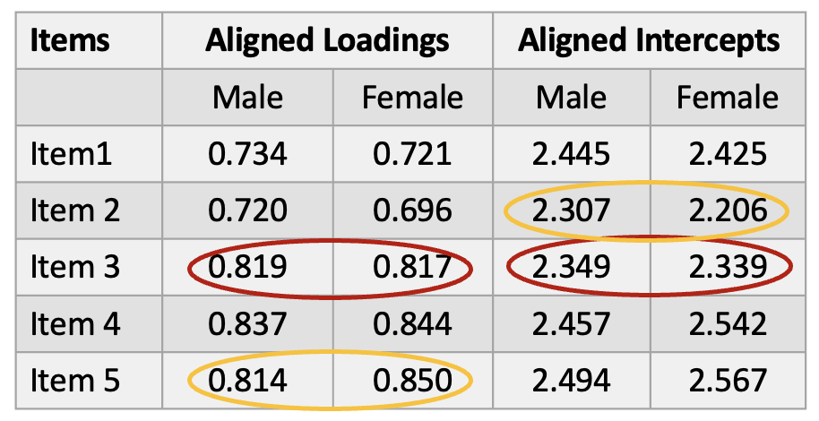
Alignment with Bayesian ROME Framework
The Bayesian ROME framework
Requires prior knowledge of noninvariant items
Conventional methods of MI testing
Alignment Optimization
Alignment (Asparouhov & Muthén, 2014)
Minimizes the amount of total measurement noninvariance
Automates the MI analysis without requiring exact MI

Slide 7
Bayesian ROME Framework
Alignment
Automates the MI analysis without requiring exact MI
Minimizes the amount of total measurement noninvariance
Generates a solution where there are a few large non-invariant measurement parameters and many approximately invariant measurement parameters

Slide 8
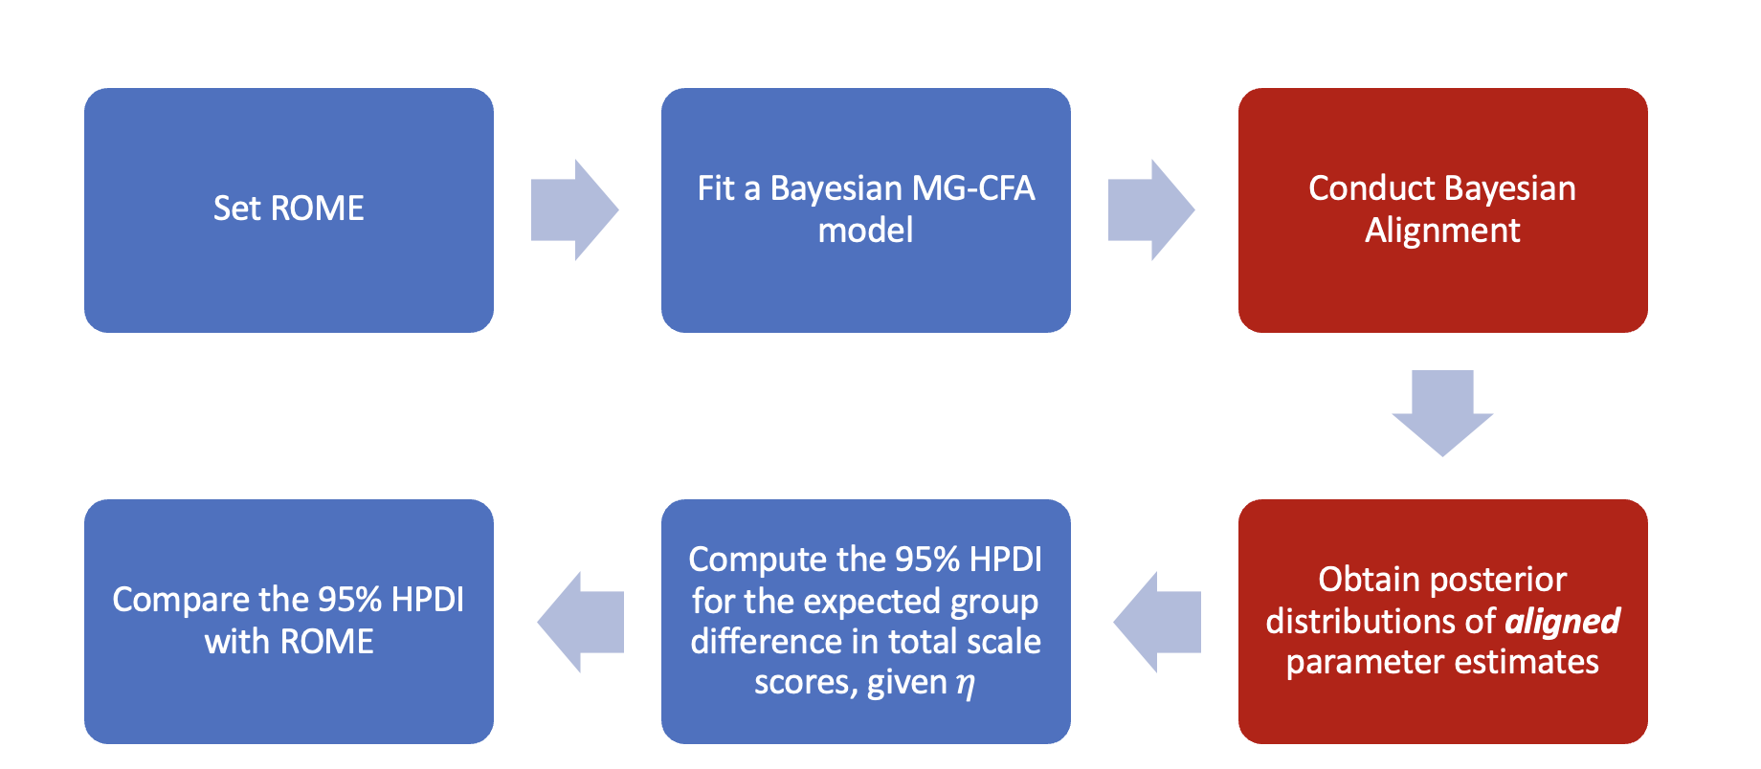
ABROME Framework

Slide 9
ABROME for Multiple Groups
Applied researchers are often interested in whether a scale is practically invariant across three or more groups (e.g., race/ethnicity)
Bayesian ROME for Multiple Groups
Test overall noninvariance across all groups
Conduct pairwise group comparisons if practical noninvariance is founded

Slide 10


ABROME for Multiple Groups
Computation of the cumulative expected group differences in scale scores (Lai et al., 2023)
Specifying ROME
For two group comparisons, $[−0.1sp, 0.1sp]$ (Cohen, 1988)
For multiple group comparisons, $[0, 0.05 sp]$ (Zhang et al., 2022)
s_{p} is the pooled standard deviation across all groups

Slide 11
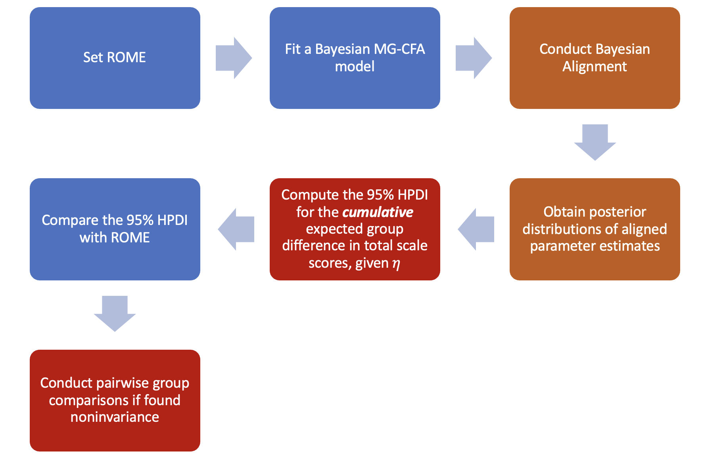
ABROME For Multiple Groups

Slide 12
Illustrative Example
Goal: Investigate practical invariance of a five-item mathematics-specific self-efficacy scale across racial groups from a nationally representative sample (Educational Longitudinal Study of 2002)
Randomly chose 2,000 grade 10 students
60.35% White
9.45% Asian
14.65% Black
10.2% Hispanic

Slide 13
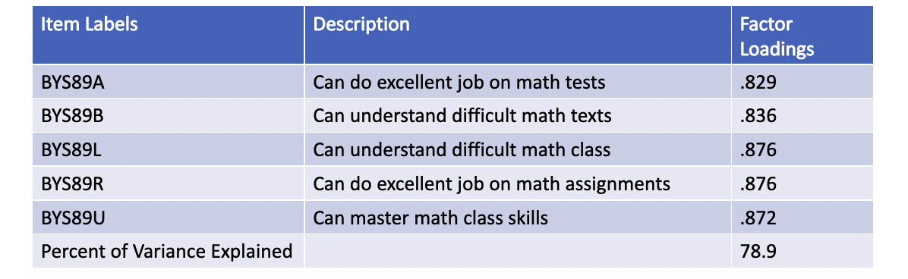
Illustrative Example
Mathematics Self-Efficacy Scale

Slide 14
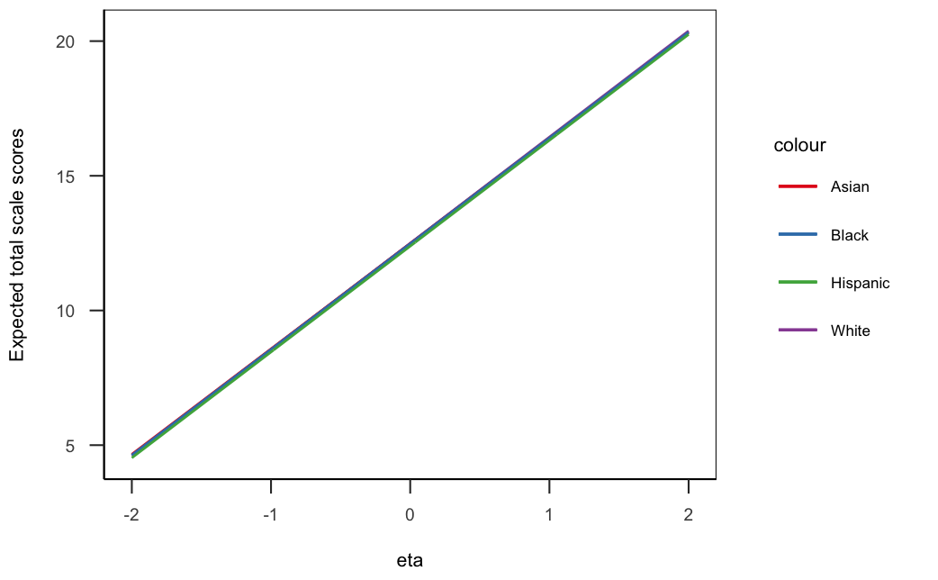
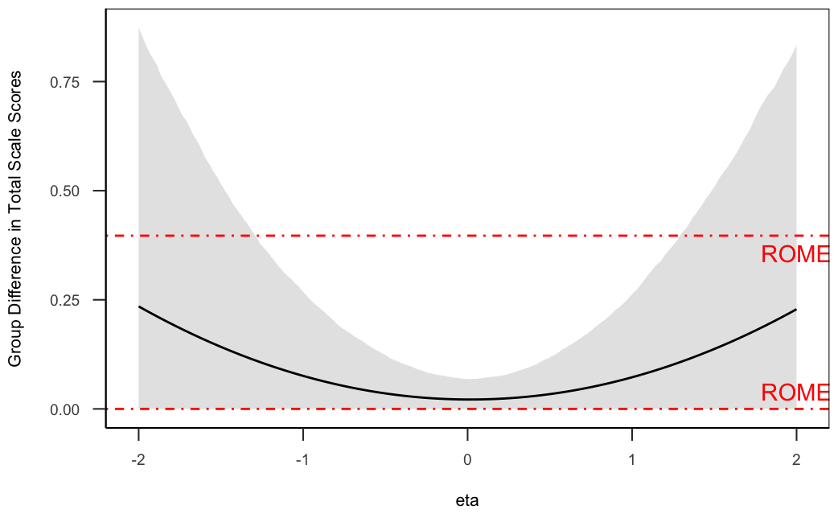
Illustrative Example - Overall
ROME was set as [0, 0.397]
Students from different racial backgrounds perform similarly
The practical significance of noninvariance remains inconclusive

Slide 15
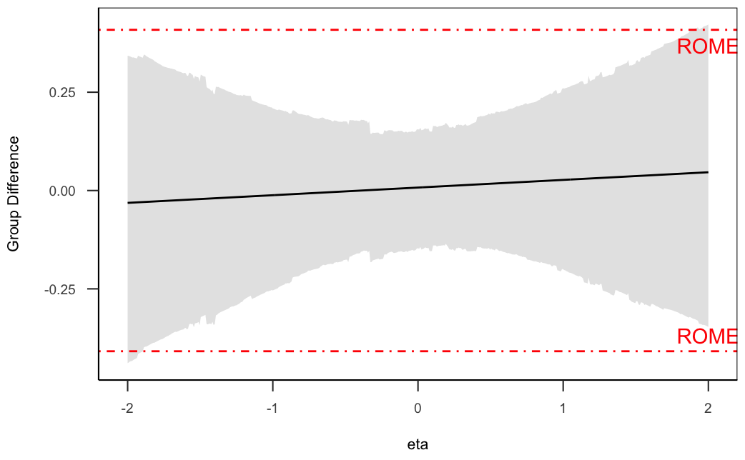
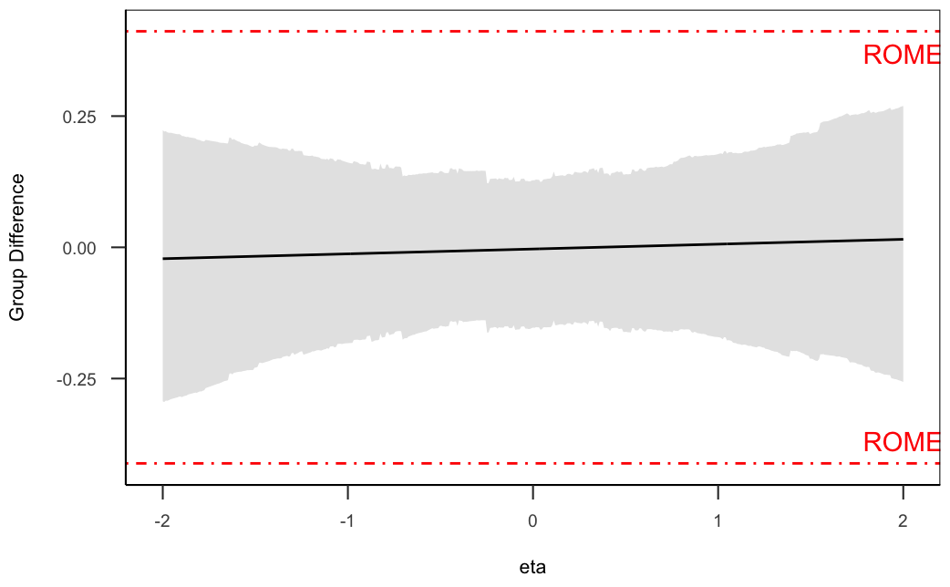
Illustrative Example – Pairwise Group Comparisons
White vs Asian
ROME [-0.409, 0.409]
White vs Black
ROME [-0.412, 0.412]

Slide 16
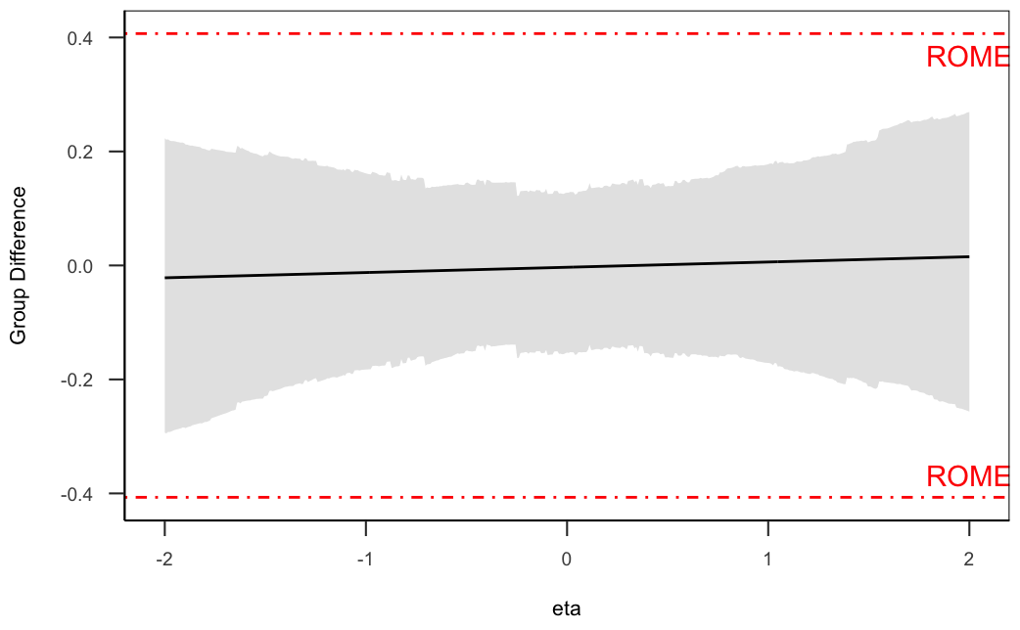
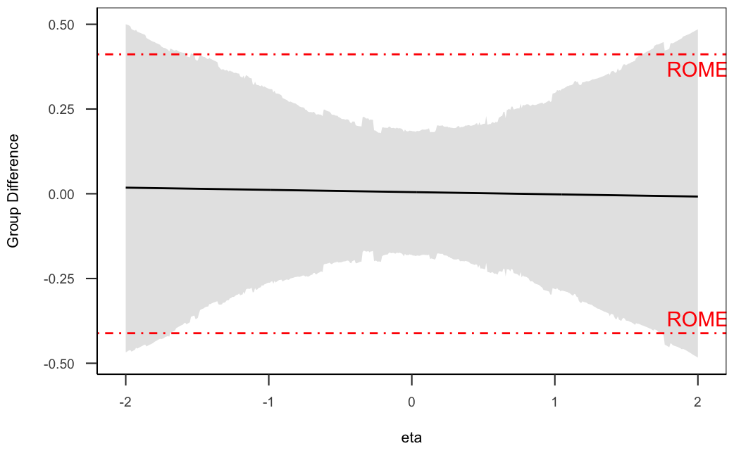
Illustrative Example – Pairwise Group Comparisons
White vs Hispanic
ROME [-0.407, 0.407]
Asian vs Black
ROME [-0.411, 0.411]
ROME
ROME
ROME
ROME

Slide 17
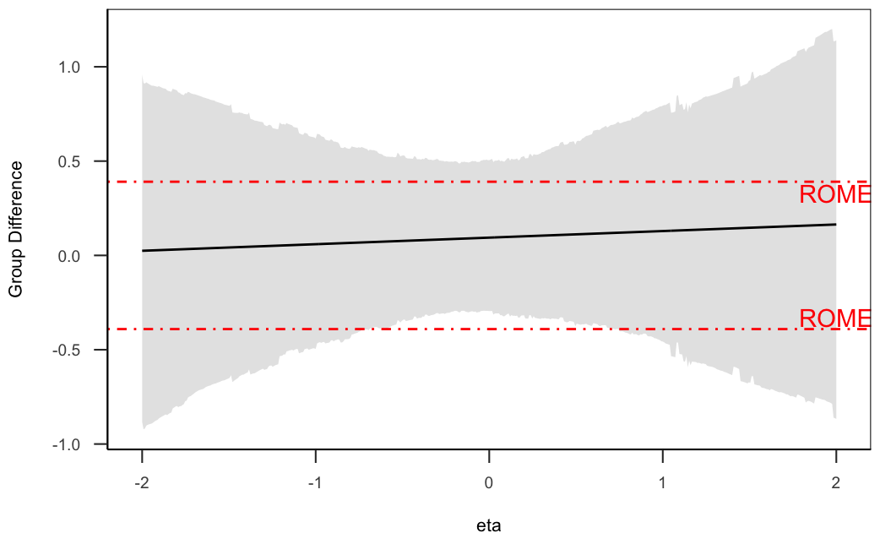
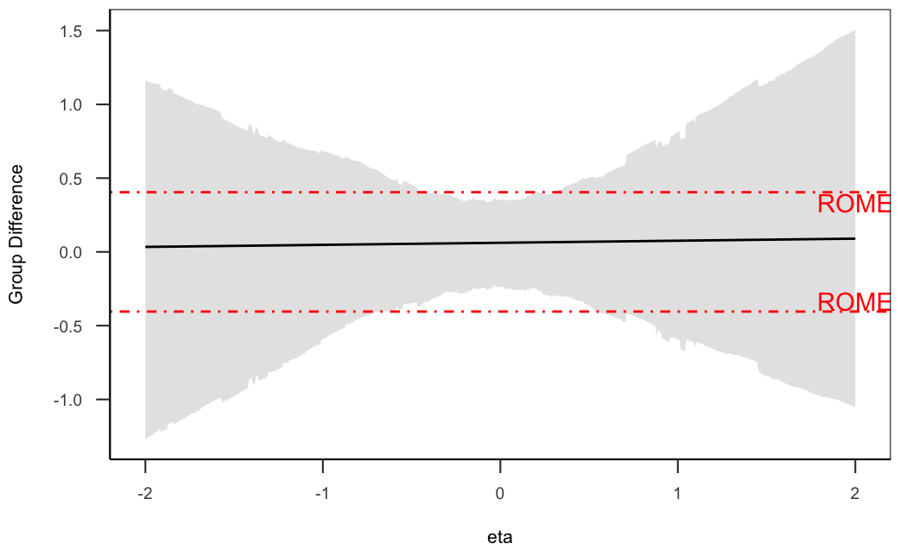
Illustrative Example – Pairwise Group Comparisons
Asian vs Hispanic
ROME [-0.391, 0.391]
Black vs Hispanic
ROME [-0.404, 0.404]

Slide 18
Results Summary
Whether the mathematics self-efficacy scale (math SE) is practically invariant across all racial groups (White, Asian, Black, Hispanic) remains inconclusive
By conducting pairwise group comparisons using the Bayesian ROME framework
Math SE is practically invariant between
White and Asian
White and Black
White and Hispanic
Further investigation is needed for
Asian vs Black
Asian vs Hispanic
Black vs Hispanic

Slide 19
Limitation and Future Directions
The ABROME with multiple groups framework could be time consuming when the number of groups is large
Consider using Bayesian ROME with Multilevel Confirmatory Factor Analysis
The 95% HPDI could be outside ROME if uncertainty is high
Increase sample size
Use anchor item

Slide 20
Contributions
The proposed Bayesian ROME with multiple groups framework
Enables researchers to support practical invariance of the scale of interest across multiple groups
Quantifies the degree of noninvariance on an easily understandable metric (observed total scale scores)
Provides more useful information
Who are mostly biased by the scale
Which pair of groups have significant bias

Slide 21
References
Asparouhov, T., & Muthén, B. (2014). Multiple-Group factor analysis alignment. Structural Equation Modeling: A Multidisciplinary Journal, 21(4), 495–508. https://doi.org/10.1080/10705511.2014.919210
Cohen, J. (1988). Statistical Power Analysis for the Behavioral Sciences (2nd edition). Routledge.
U.S. Department of Education, National Center for Education Statistics. (2004). Education longitudinal study of 2002: Base year data file user’s manual, by Steven J. Ingels, Daniel J. Pratt, James E. Rogers, Peter H. Siegel, and Ellen S. Stutts. Washington, DC.
Yuan, K.-H., & Chan, W. (2016). Measurement invariance via multigroup SEM: Issues and solutions with chi-square-difference tests. Psychological Methods, 21(3), 405–426. https://doi.org/10.1037/met0000080
Zhang, Y., Lai, M. H. C., & Palardy, G. J. (2022). A Bayesian region of measurement equivalence (ROME) approach for establishing measurement invariance. Psychological Methods. Advance online publication. https://doi.org/10.1037/met0000455
Zhang, Y., Lai, M. H. C. (2022). Bayesian region of measurement equivalence (ROME) approach with Alignment [Manuscript in preparation].
Notes:
I will add more references

Slide 22
Thank you!
Feel free to contact me via email (yzhang97@usc.edu)

Slide 23
Bayesian ROME Framework
Set ROME
Fit a Bayesian MG-CFA model
Compare the 95% HPDI with ROME
Obtain posterior distributions of parameter estimates
Compute the 95% HPDI for the expected group difference in total scale scores, given $η$
Compute the 95% HPDI for the expected group difference in total scale scores, given 𝜂

Slide 24
ABROME Framework
Set ROME
Fit a Bayesian MG-CFA model
Conduct Bayesian Alignment
Obtain posterior distributions of aligned parameter estimates
Compute the 95% HPDI for the expected group difference in total scale scores, given $η$
Compute the 95% HPDI for the expected group difference in total scale scores, given 𝜂
Compare the 95% HPDI with ROME

Slide 25
ABROME For Multiple Groups
Set ROME
Fit a Bayesian MG-CFA model
Conduct Bayesian Alignment
Obtain posterior distributions of aligned parameter estimates
Compute the 95% HPDI for the cumulative expected group difference in total scale scores, given $η$
Compute the 95% HPDI for the cumulative expected group difference in total scale scores, given 𝜂
Compare the 95% HPDI with ROME
Conduct pairwise group comparisons if found noninvariance

